Slide 1
Chapter 4
Entity Relationship (ER) Modeling

Slide 2
Learning Objectives
After completing this chapter, you will be able to:
Identify the main characteristics of entity relationship components
Describe how relationships between entities are defined, refined, and incorporated into the database design process
See how ERD components affect database design and implementation
Understand that real-world database design often requires the reconciliation of conflicting goals

Slide 3
The Entity Relationship Model (ERM)
Forms the basis of an entity relationship diagram (ERD)
Conceptual database as viewed by end user
Database’s main components
Entities
Attributes
Relationships

Slide 4
Entities
Object of interest to the end user
Refers to the entity set and not to a single entity occurrence
ERM corresponds to a table—not to a row—in the relational environment
ERM refers to a table row as an entity instance or entity occurrence
In Chen, Crow’s Foot, and UML notations, an entity is represented by a rectangle that contains the entity’s name
The entity name, a noun, is usually written in all capital letters

Slide 5
Attributes (1 of 7)
Characteristics of entities
Required attribute: must have a value and cannot be left empty
Optional attribute: does not require a value and can be left empty
Domain: set of possible values for a given attribute
Identifier: one or more attributes that uniquely identify each entity instance
Composite identifier: primary key composed of more than one attribute
Composite attribute: attribute that can be subdivided to yield additional attributes
Simple attribute: attribute that cannot be subdivided
Single-valued attribute: attribute that has only a single value
Multivalued attributes: attributes that have many values

Slide 6
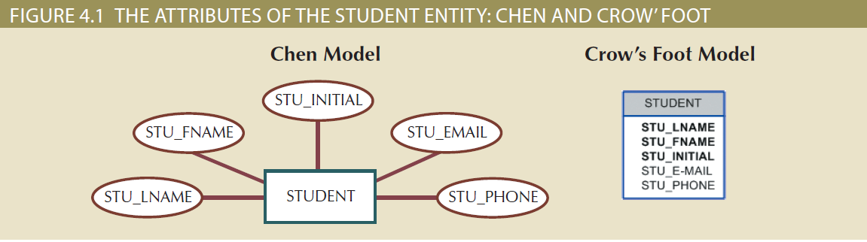
Attributes (2 of 7)

Slide 7
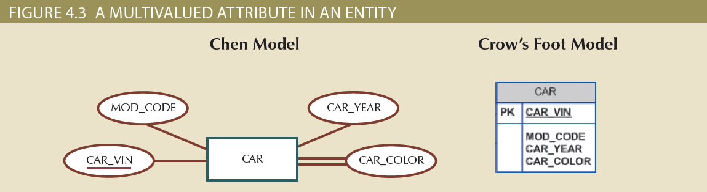
Attributes (3 of 7)

Slide 8
Attributes (4 of 7)
Requirements of multivalued attributes
Create several new attributes, one for each component of the original multivalued attribute
Develop a new entity composed of the original multivalued attribute’s components
Derived attribute: attribute whose value is calculated from other attributes
Derived using an algorithm

Slide 9
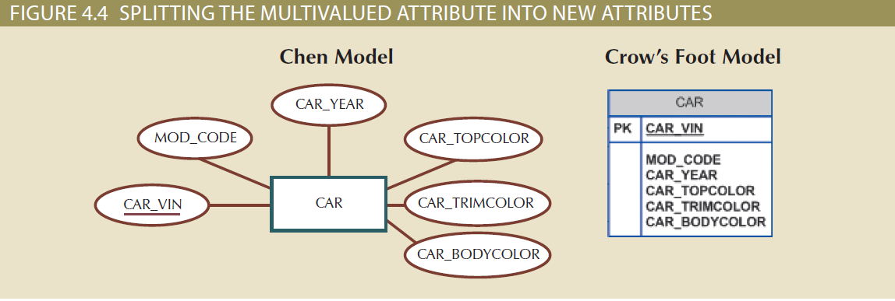
Attributes (5 of 7)

Slide 10
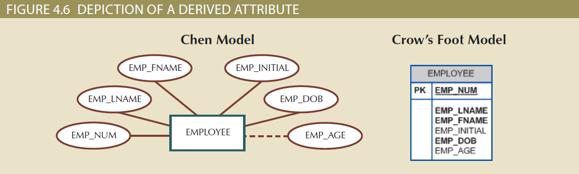
Attributes (6 of 7)

Slide 11
Attributes (7 of 7)
Table 4.2 | Advantages and Disadvantages of Storing Derived Attributes
 | Derived Attribute: Stored | Derived Attribute: Not Stored
Advantage | Saves CPU processing cycles Saves data access time Data value is readily available Can be used to keep track of historical data | Saves storage space Computation always yields current value
Disadvantage | Requires constant maintenance to ensure derived value is current, especially if any values used in the calculation change | Uses CPU processing cycles Increases data access time Adds coding complexity to queries

Slide 12
Relationships, Connectivity, and Cardinality
Association between entities that always operate in both directions
Participants: entities that participate in a relationship
Connectivity: describes the relationship classification
Include 1:1, 1:M, and M:N
Cardinality: expresses the minimum and maximum number of entity occurrences associated with one occurrence of related entity
In the ERD, cardinality is indicated by placing the appropriate numbers beside the entities, using the format (x, y)

Slide 13
Existence Dependence
Existence dependence
Entity exists in the database only when it is associated with another related entity occurrence
Existence independence
Entity exists apart from all of its related entities
Referred to as a strong entity or regular entity

Slide 14
Relationship Strength
Weak (non-identifying) relationship
Primary key of the related entity does not contain a primary key component of the parent entity
Strong (identifying) relationships
Primary key of the related entity contains a primary key component of the parent entity

Slide 15
Weak Entities (1 of 3)
Conditions of a weak entity
Existence-dependent
Has a primary key that is partially or totally derived from parent entity in the relationship
Database designer determines whether an entity is weak
Based on business rules

Slide 16
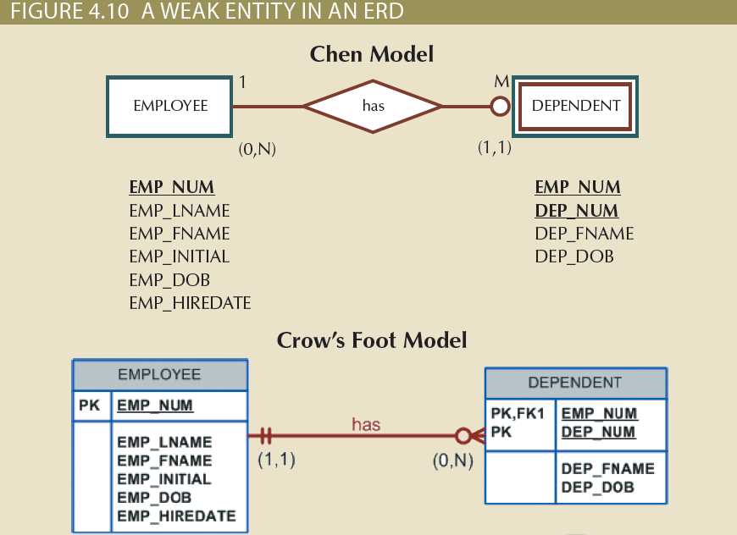
Weak Entities (2 of 3)

Slide 17
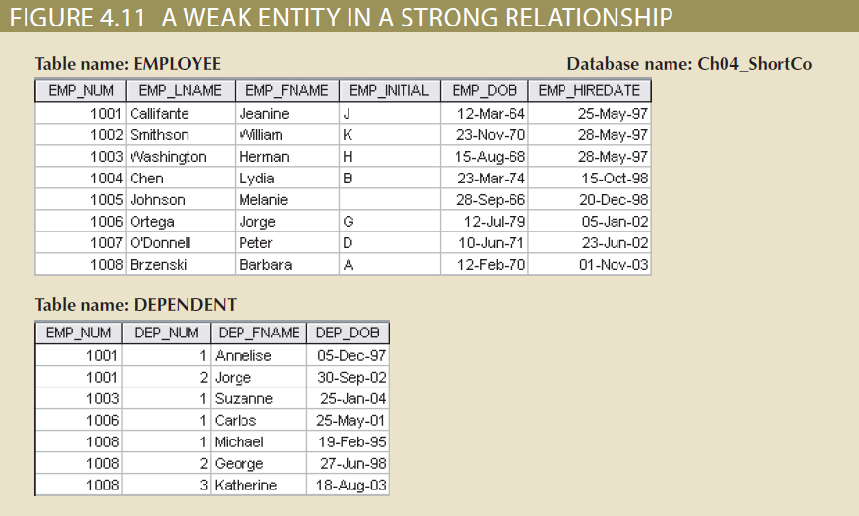
Weak Entities (3 of 3)

Slide 18
Relationship Participation (1 of 3)
Optional participation
One entity occurrence does not require a corresponding entity occurrence in a particular relationship
Mandatory participation
One entity occurrence requires a corresponding entity occurrence in a particular relationship

Slide 19
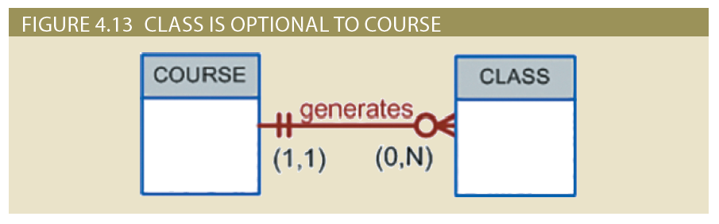
Relationship Participation (2 of 3)

Slide 20
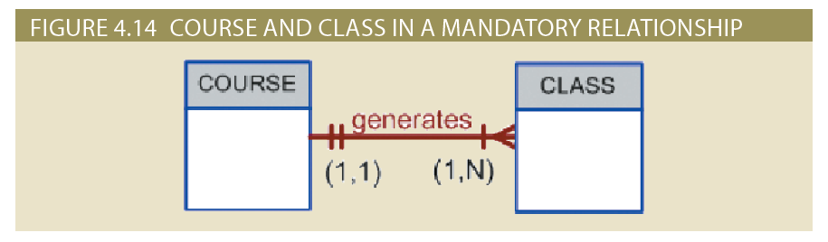
Relationship Participation (3 of 3)

Slide 21
Relationship Degree (1 of 2)
Indicates the number of entities or participants associated with a relationship
Unary relationship: association is maintained within a single entity
Binary relationship: two entities are associated
Ternary relationship: three entities are associated
Recursive relationship: relationship exists within a single entity type

Slide 22
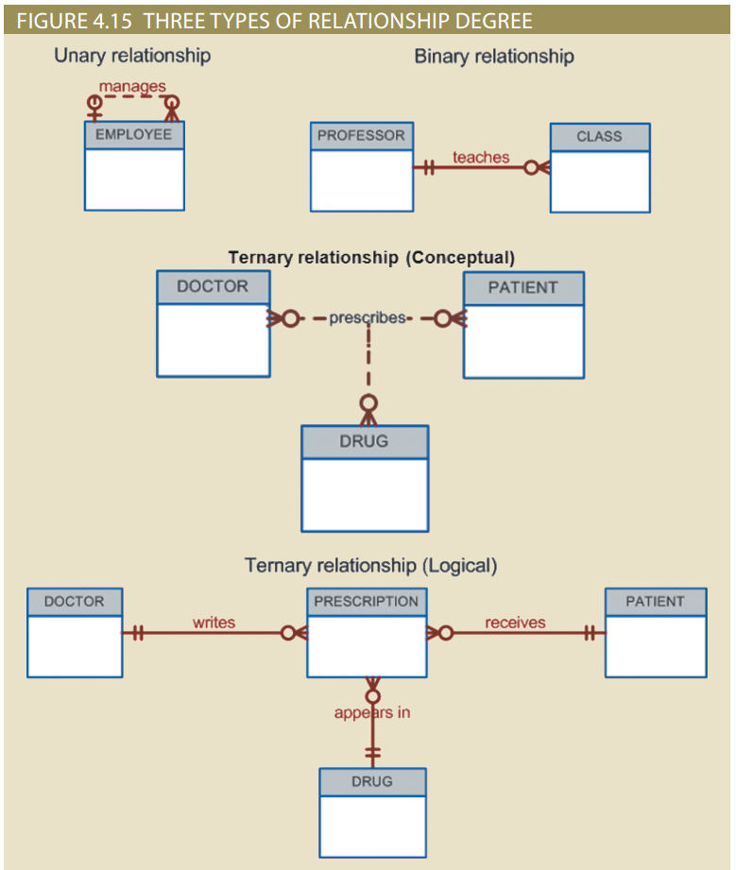
Relationship Degree (2 of 2)

Slide 23
Recursive Relationships (1 of 2)
Relationship can exist between occurrences of the same entity set
Naturally, such a condition is found within a unary relationship
Common in manufacturing industries
One common pitfall when working with unary relationships is to confuse participation with referential integrity
Similar because they are both implemented through constraints on the same set of attributes

Slide 24
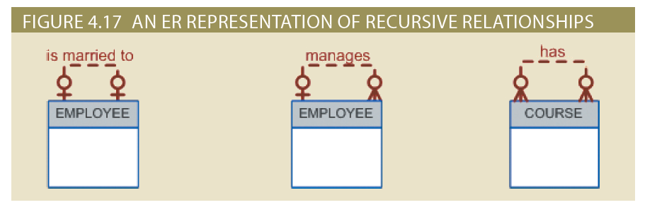
Recursive Relationships (2 of 2)

Slide 25
Associative (Composite) Entities (1 of 2)
Used to represent an M:N relationship between two or more entities
Has a 1:M relationship with the parent entities
Composed of the primary key attributes of each parent entity
May also contain additional attributes that play no role in connective process

Slide 26
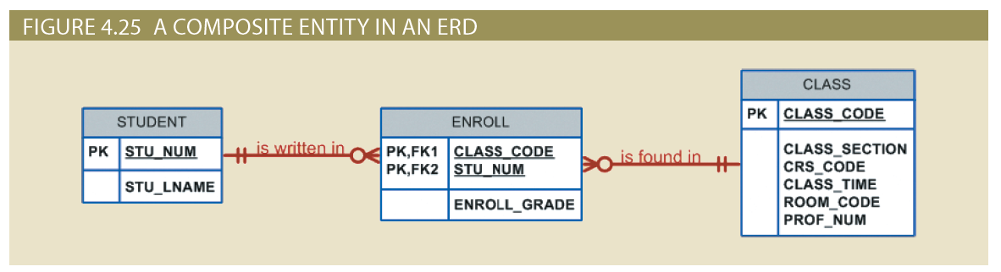
Associative (Composite) Entities (2 of 2)

Slide 27
Developing an ER Diagram (1 of 11)
Activities involved in building and ERD
Create a detailed narrative of the organization’s description of operations
Identify business rules based on the descriptions
Identify main entities and relationships from the business rules
Develop the initial ERD
Identify the attributes and primary keys that adequately describe entities
Revise and review ERD

Slide 28
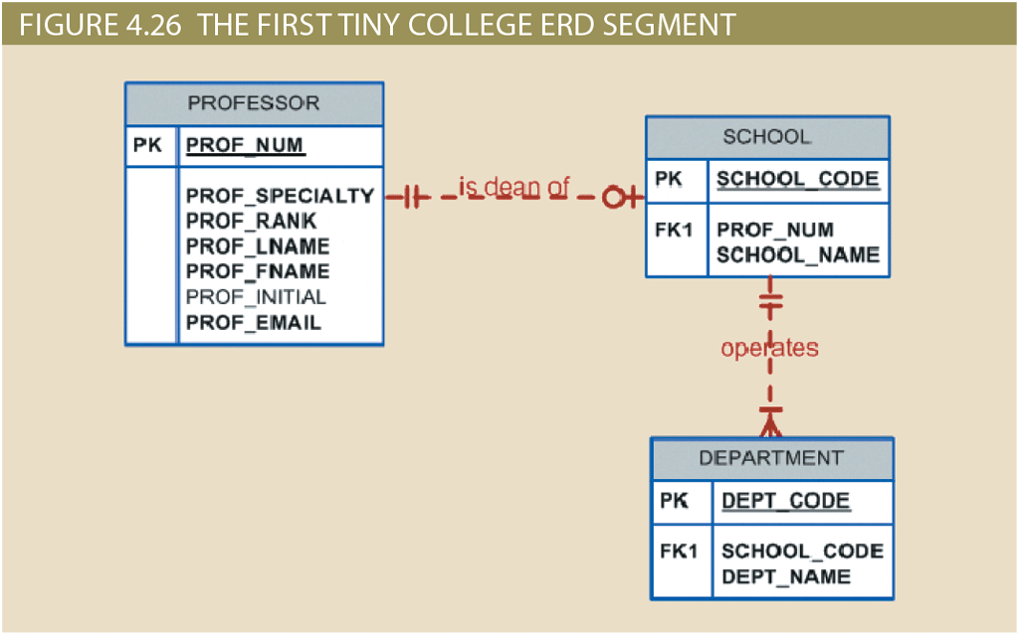
Developing an ER Diagram (2 of 11)

Slide 29
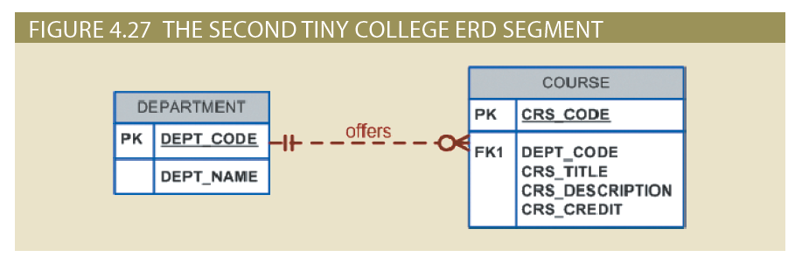
Developing an ER Diagram (3 of 11)

Slide 30
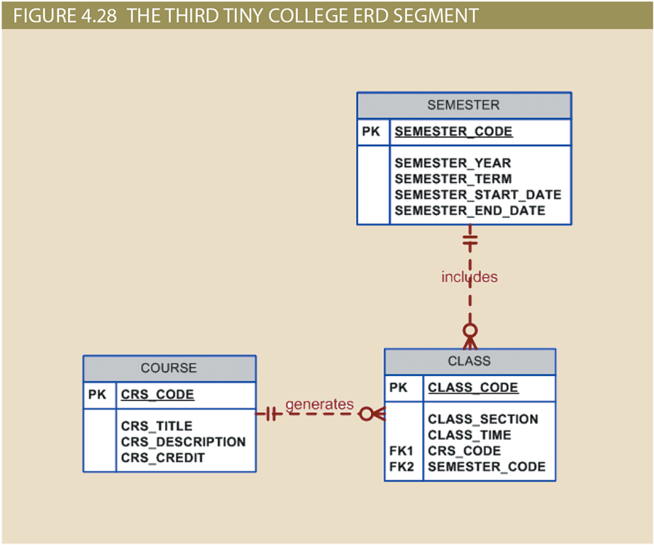
Developing an ER Diagram (4 of 11)

Slide 31
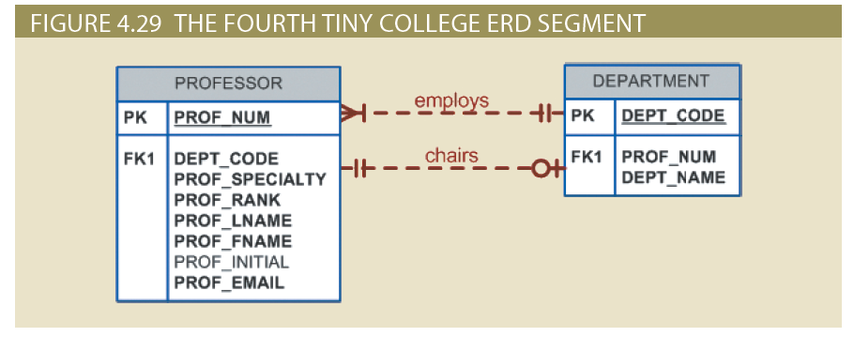
Developing an ER Diagram (5 of 11)

Slide 32
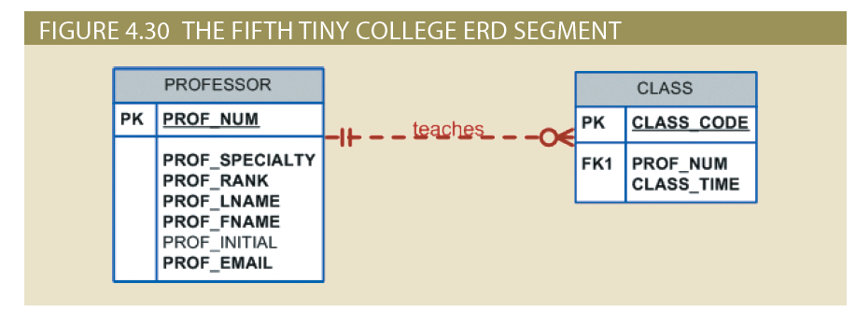
Developing an ER Diagram (6 of 11)

Slide 33
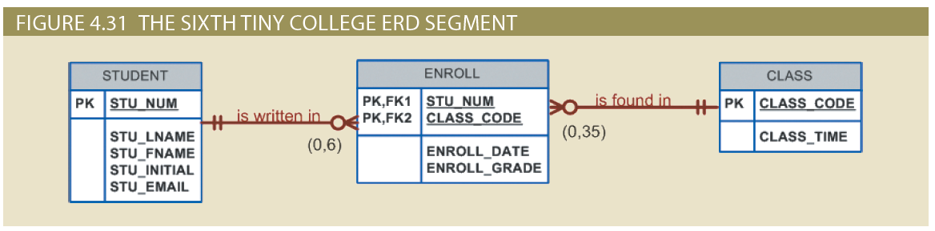
Developing an ER Diagram (7 of 11)

Slide 34
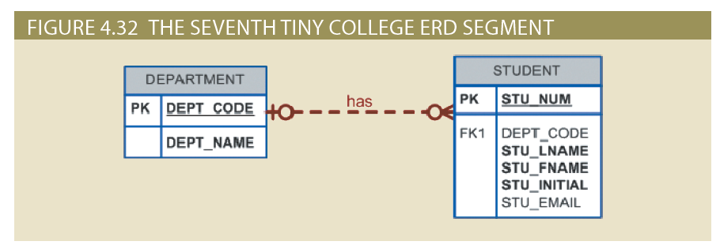
Developing an ER Diagram (8 of 11)

Slide 35
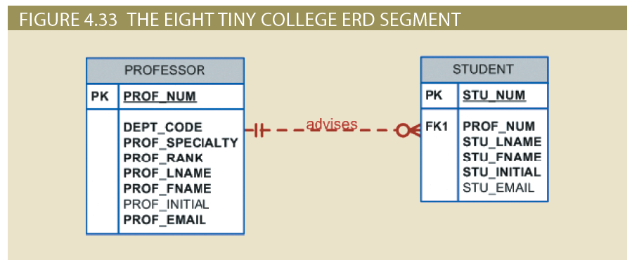
Developing an ER Diagram (9 of 11)

Slide 36
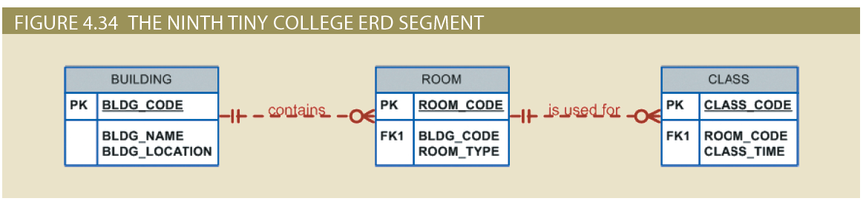
Developing an ER Diagram (10 of 11)

Slide 37
Developing an ER Diagram (11 of 11)
Table 4.4 | Components of the ERM
Entity | Relationship | Connectivity | Entity
SCHOOL | operates | 1:M | DEPARTMENT
DEPARTMENT | has | 1:M | STUDENT
DEPARTMENT | employs | 1:M | PROFESSOR
DEPARTMENT | offers | 1:M | COURSE
COURSE | generates | 1:M | CLASS
SEMESTER | includes | 1:M | CLASS
PROFESSOR | is dean of | 1:1 | SCHOOL
PROFESSOR | chairs | 1:1 | DEPARTMENT
PROFESSOR | teaches | 1:M | CLASS
PROFESSOR | advises | 1:M | STUDENT
STUDENT | enrolls in | M:N | CLASS
BUILDING | contains | 1:M | ROOM
ROOM | is used for | 1:M | CLASS
 | Note: ENROLL is the composite entity that implements the M:N relationship “STUDENT enrolls in CLASS.”

Slide 38
Database Design Challenges: Conflicting Goals (1 of 2)
Database designers must often make design compromises that are triggered by conflicting goals
Database design must conform to design standards
High processing speed may limit the number and complexity of logically desirable relationships
Maximum information generation may lead to loss of clean design structures and high transaction speed

Slide 39
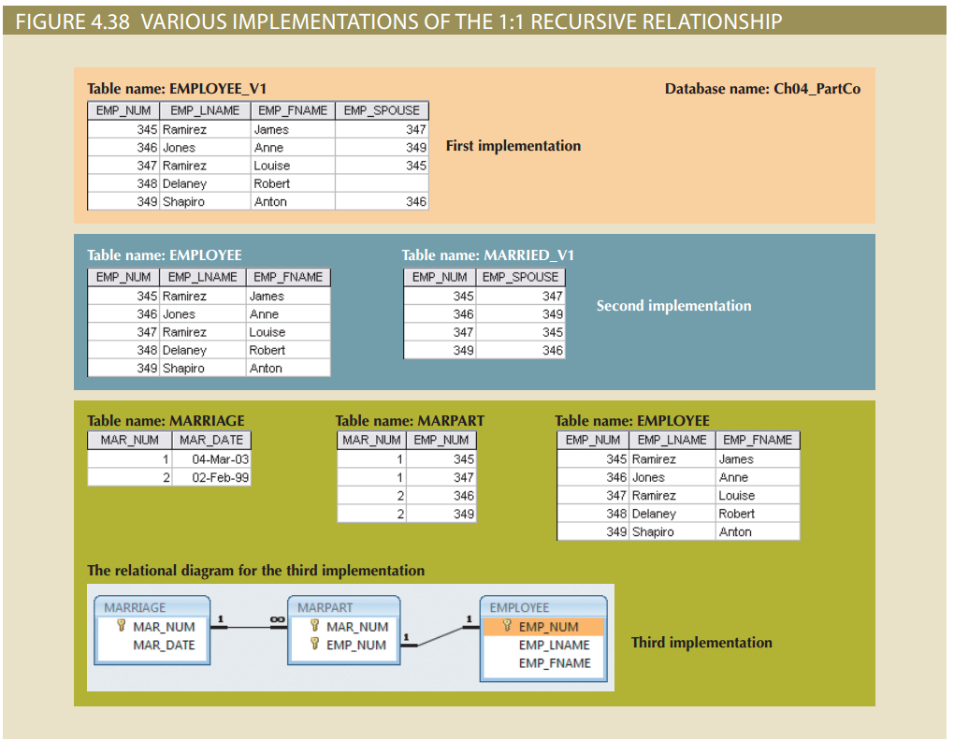
Database Design Challenges: Conflicting Goals (2 of 2)

Slide 40
Summary
The ERM uses ERDs to represent the conceptual database as viewed by the end user
Connectivity describes the relationship classification (1:1, 1:M, or M:N)
In the ERM, an M:N relationship is valid at the conceptual level
ERDs may be based on many different ERMs
Unified Modeling Language (UML) class diagrams are used to represent the static data structures in a data model
Database designers, no matter how well they can produce designs that conform to all applicable modeling conventions, are often forced to make design compromises

